Slide 1



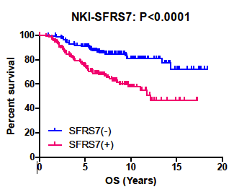
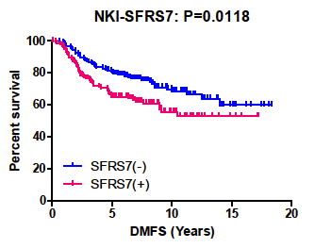

Characterizing the role of SFRS7, a Ser/Arg-rich splicing factor
in breast cancer metastasis
Sean Cai^{2,3}, Grace Cheung³, Nisha Kanwar^{2,3}, Dong-Yu Wang³, Susan J. Done^{1,2,3,4}
Departments of ¹Medical Biophysics and ²Laboratory Medicine and Pathobiology, University of Toronto; ³The Campbell Family Institute for Breast Cancer Research, Princess Margaret Hospital; ⁴Department of Pathology, Toronto General Hospital, University Health Network, Toronto, ON, Canada
BACKGROUND
Cell culture and transfection
MCF7 and CAMA1 cell line was maintained in DMEM supplemented with 10% FBS and antibiotics
MCF7 was transfected with Stealth Select RNAi™ siRNA according to the manufacturer's protocols
CAMA1 was transfected with gene plasmids purchased from Origene
Both transfections used Lipofectamine™ according to the manufacturer’s protocols
Migration assay
Transfected cells were plated in BD BioCoat Matrigel ™ Invasion Chambers (24-well)
10% fetal bovine serum was used as the chemoattractant
Cells were fixed and stained using a Diff-Quik™ kit
Proliferation assay
2000 transfected cells were plated in each well of a 96-well plate
Absorbance at 490nm was measured 3 hours after adding 20uL of Cell Titer 96® Aqueous One Solution to each well
Measurements were obtained at 24 hour intervals over 4 days
Breast cancer is a highly heterogeneous condition
Metastatic breast cancer is associated with poor prognosis and can lead to death
Our lab identified 4 genomic regions that are over-amplified in invasive breast cancer including 2p21-22
SFRS7 lies within this region
SFRS family members have been reported to aid carbohydrate-dependent cancer cell localization to lungs in mice
MCF10
MCF7
SKBR
CAMA1
Hs578T
MDAMB468
MDAMB157
BT549
MDAMB231
Over-expression of SFRS7 in CAMA1 cell line and its effect on cell migration
PURPOSE
CONCLUSION
To determine role of SFRS7 in breast cancer proliferation/migration through in vitro assays
Also to determine its levels in patient samples
Western blot assaying SFRS7 levels across 9 cell lines and their relative expression to beta-actin
SFRS7 expression is strongly correlated with rates of survival, tumour size, estrogen receptor and triple negative breast cancer
siRNA knockdown of SFRS7 in MCF7 results in a significant decrease in cell proliferation
Over expression of SFRS7 in CAMA1 results in a dramatic increase in cell migration
SFRS7 has potential to be a biomarker for breast cancer metastasis and a target gene for therapeutic treatment
METHODS
MCF7 siRNA knockdown
24 Hours
48 Hours
Western blotting
Protein levels were assayed across 9 cell lines: MCF10A, CAMA1, SKBR, MDA-MB-468, MCF7, MDA-MB-231, Hs578T, MDA-MB-157 and BT549.
Cells were cultured in normal conditions and lysed using the CytoBusterTM protein extraction reagent
Supernatants were collected by micro-centrifugation at 14,000rpm at 4ºC for 5 minutes
Bio-Rad Quantity One® program was used to determine concentration of proteins
Western blotting was completed according to standard protocols
SFRS7 siRNA and Antibodies
Stealth Select RNAi™ siRNA from Invitrogen was used to reduce the expression of SFRS7
Anti-SFRS7 antibody was purchased from Proteintech Group Inc.
RESULTS
ACKNOWLEDGEMENTS
We thank Dr. Done for her tremendous support and supervision. We also thank Ranju Nair for her technical consults and insightful discussions
REFERENCES
Absorbance (490 nm)
1. Wang, C et al. Genomic alterations in primary breast cancers compared with their sentinel and more distal lymph node metastases: an aCGH study. Genes Chromosomes Cancer 48, 1091-10(2009).
2. Hatakeyama, S et al. Identification of mRNA splicing factors as the endothelial receptor for carbohydrate-dependent lung colonization of cancer cells. Proc Natl Acad Sci USA, 106, 1091-101(2009
 | DEATH | GRADE | SIZE | ER | Triple (-)
P value | <0.0001 | <0.0001 | 0.01953 | <0.0001 | <0.0001
Correlation between SFRS7 expression in patient samples and clinical factors
Hours after transfection
siRNA knockdown of SFRS7 in MCF7 cell line and its effect on cell proliferation
This project is funded by
Canadian Breast Cancer Foundation

